Slide 1
Advanced Databases Lecture 9: Transactions and Concurrency
Dr. Pierpaolo Dondio,

Slide 2
1 Introduction to Transaction Processing
Single-User System: At most one user at a time can use the system.
Multiuser System: Many users can access the system concurrently.
Concurrency
Interleaved processing: concurrent execution of processes is interleaved in a single CPU
Parallel processing: processes are concurrently executed in multiple CPUs.

Slide 3
Introduction to Transaction Processing
A Transaction: logical unit of database processing that includes one or more access operations (read -retrieval, write - insert or update, delete).
A transaction (set of operations) may be stand-alone specified in a high level language like SQL submitted interactively, or may be embedded within a program.
Transaction boundaries: Begin and End transaction.
An application program may contain several transactions separated by the Begin and End transaction boundaries.

Slide 4
Introduction to Transaction Processing
SIMPLE MODEL OF A DATABASE (for purposes of discussing transactions):
A database - collection of named data items
Granularity of data - a field, a record , or a whole disk block (Concepts are independent of granularity)
Basic operations are read and write
read_item(X): Reads a database item named X into a program variable. To simplify our notation, we assume that the program variable is also named X.
write_item(X): Writes the value of program variable X into the database item named X.

Slide 5
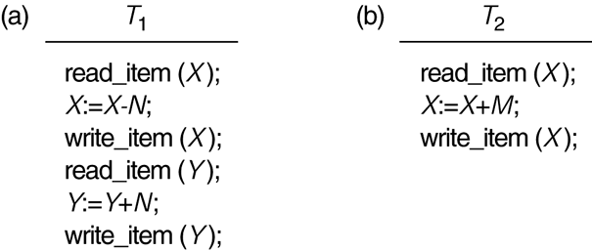
Two sample transactions T₁ and T₂.

Slide 6
Introduction to Transaction Processing
Why Concurrency Control is needed:
The Lost Update Problem.
This occurs when two transactions that access the same database items have their operations interleaved in a way that makes the value of some database item incorrect.
The Temporary Update (or Dirty Read) Problem.
This occurs when one transaction updates a database item and then the transaction fails for some reason (see Section 17.1.4). The updated item is accessed by another transaction before it is changed back to its original value.

Slide 7
Introduction to Transaction Processing
Why Concurrency Control is needed (cont.):
The Incorrect Summary Problem .
If one transaction is calculating an aggregate summary function on a number of records while other transactions are updating some of these records, the aggregate function may calculate some values before they are updated and others after they are updated.

Slide 8
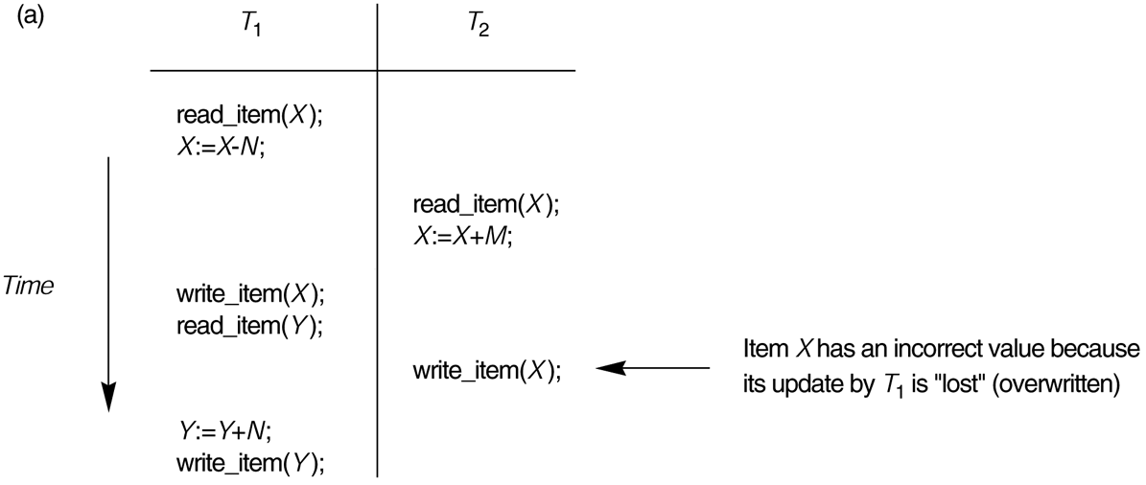
The lost update problem.

Slide 9
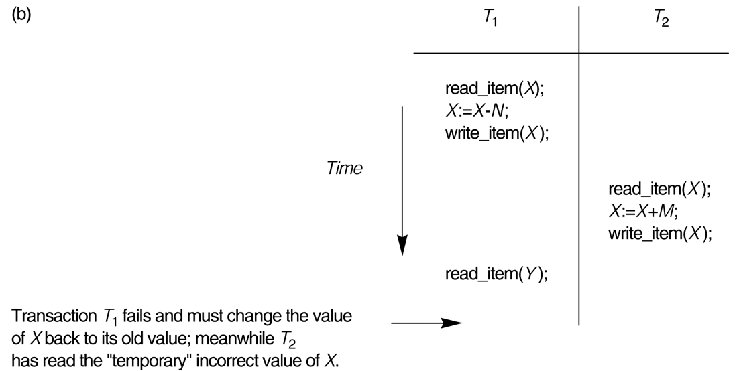
The temporary update problem.

Slide 10
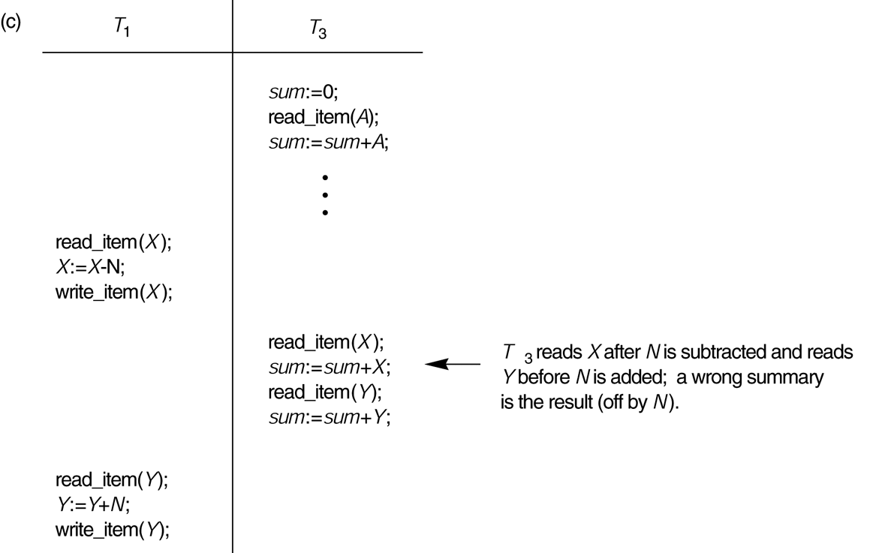
The incorrect summary problem.

Slide 11
Introduction to Transaction Processing
Why recovery is needed:
(What causes a Transaction to fail)
1. A computer failure (system crash): A hardware or software error occurs in the computer system during transaction execution. If the hardware crashes, the contents of the computer’s internal memory may be lost.
2. A transaction or system error : Some operation in the transaction may cause it to fail, such as integer overflow or division by zero. Transaction failure may also occur because of erroneous parameter values or because of a logical programming error. In addition, the user may interrupt the transaction during its execution.

Slide 12
Introduction to Transaction Processing
Why recovery is needed (cont.):
3. Local errors or exception conditions detected by the transaction:
- certain conditions necessitate cancellation of the transaction. For example, data for the transaction may not be found. A condition, such as insufficient account balance in a banking database, may cause a transaction, such as a fund withdrawal from that account, to be canceled.
- a programmed abort in the transaction causes it to fail.
4. Concurrency control enforcement: The concurrency control method may decide to abort the transaction, to be restarted later, because it violates serializability or because several transactions are in a state of deadlock

Slide 13
Introduction to Transaction Processing
Why recovery is needed (cont.):
5. Disk failure: Some disk blocks may lose their data because of a read or write malfunction or because of a disk read/write head crash. This may happen during a read or a write operation of the transaction.
6. Physical problems and catastrophes: This refers to an endless list of problems that includes power or air-conditioning failure, fire, theft, sabotage, overwriting disks or tapes by mistake, and mounting of a wrong tape by the operator.

Slide 14
2 Transaction and System Concepts
A transaction is an atomic unit of work that is either completed in its entirety or not done at all. For recovery purposes, the system needs to keep track of when the transaction starts, terminates, and commits or aborts.
Transaction states:
Active state
Partially committed state
Committed state
Failed state
Terminated State

Slide 15
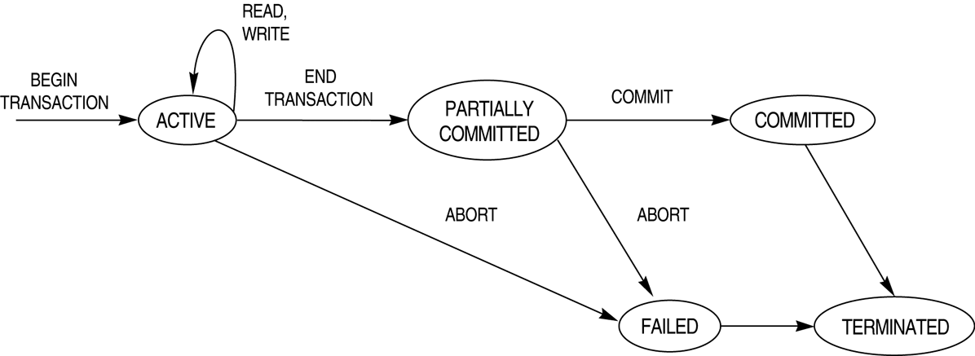
State diagram illustrating the states for transaction execution.

Slide 16
3 Desirable Properties of Transactions
ACID properties:
Atomicity: A transaction is an atomic unit of processing; it is either performed in its entirety or not performed at all.
Consistency preservation: A correct execution of the transaction must take the database from one consistent state to another.

Slide 17
Desirable Properties of Transactions
ACID properties (cont.):
Isolation: A transaction should not make its updates visible to other transactions until it is committed; this property, when enforced strictly, solves the temporary update problem and makes cascading rollbacks of transactions unnecessary.
Durability or permanency: Once a transaction changes the database and the changes are committed, these changes must never be lost because of subsequent failure.

Slide 18
Transations Manager
The transaction manager enforces the ACID properties
It schedules the operations of transactions • COMMIT and ROLLBACK are used to ensure atomicity
Locks or timestamps are used to ensure consistency and isolation for concurrent transactions
A log is kept to ensure durability in the event of system failure

Slide 19
Transaction and System Concepts
Recovery techniques use the following operators:
undo: Similar to rollback except that it applies to a single operation rather than to a whole transaction.
redo: This specifies that certain transaction operations must be redone to ensure that all the operations of a committed transaction have been applied successfully to the database.

Slide 20
Transaction and System Concepts
The System Log
Log or Journal : The log keeps track of all transaction operations that affect the values of database items. This information may be needed to permit recovery from transaction failures. The log is kept on disk, so it is not affected by any type of failure except for disk or catastrophic failure. In addition, the log is periodically backed up to archival storage (tape) to guard against such catastrophic failures.
T in the following discussion refers to a unique transaction-id that is generated automatically by the system and is used to identify each transaction:

Slide 21
Transaction and System Concepts
The System Log (cont):
Types of log record:
[start_transaction,T]: Records that transaction T has started execution.
[write_item,T,X,old_value,new_value]: Records that transaction T has changed the value of database item X from old_value to new_value.
[read_item,T,X]: Records that transaction T has read the value of database item X.
[commit,T]: Records that transaction T has completed successfully, and affirms that its effect can be committed (recorded permanently) to the database.
[abort,T]: Records that transaction T has been aborted.

Slide 22
Transaction and System Concepts
Recovery using log records:
If the system crashes, we can recover to a consistent database state by examining the log
Because the log contains a record of every write operation that changes the value of some database item, it is possible to undo the effect of these write operations of a transaction T by tracing backward through the log and resetting all items changed by a write operation of T to their old_values.
We can also redo the effect of the write operations of a transaction T by tracing forward through the log and setting all items changed by a write operation of T (that did not get done permanently) to their new_values.

Slide 23
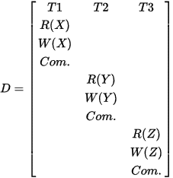
4 Characterizing Schedules based on Recoverability
Transaction schedule: When transactions are executing concurrently in an interleaved fashion, the order of execution of operations from the various transactions forms a transaction schedule.
A schedule (or history) S of n transactions T1, T2, ..., Tn :
It is an ordering of the operations of the transactions subject to the constraint that, for each transaction Ti that participates in S, the operations of T1 in S must appear in the same order in which they occur in T1. Note, however, that operations from other transactions Tj can be interleaved with the operations of Ti in S.
Two operations are conflicting if the belongs to 2 active transactions and at least one of the 2 is a write and they use the same data item

Slide 24
Characterizing Schedules based on Recoverability
Schedules classified on recoverability:
Recoverable schedule: One where no transaction needs to be rolled back.
A schedule S is recoverable if no transaction T in S commits until all transactions T’ that have written an item that T reads have committed. Still cascading rollback of uncommitted transactions possible!
Cascadeless schedule: One where every transaction reads only the items that are written by committed transactions.
Schedules requiring cascaded rollback: A schedule in which uncommitted transactions that read an item from a failed transaction must be rolled back.

Slide 25
Characterizing Schedules based on Recoverability
Schedules classified on recoverability (cont.):
Strict Schedules: A schedule in which a transaction can neither read or write an item X until the last transaction that wrote X has committed.

Slide 26
Characterizing Schedules based on Serializability
Serial schedule: A schedule S is serial if, for every transaction T participating in the schedule, all the operations of T are executed consecutively in the schedule. Otherwise, the schedule is called nonserial schedule.
Serializable schedule: A schedule S is serializable if it is equivalent to some serial schedule of the same n transactions.

Slide 27
Characterizing Schedules based on Serializability
Being serializable implies that the schedule is a correct schedule.
It will leave the database in a consistent state.
The interleaving is appropriate and will result in a state as if the transactions were serially executed, yet will achieve efficiency due to concurrent execution.
Being serializable is not the same as being serial

Slide 28
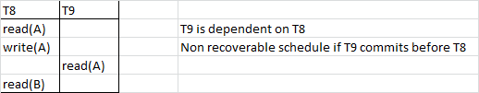
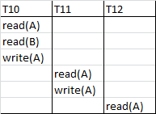
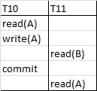
Schedule Examples
Recoverable if…
T8 commits!
Subject to cascade
Cascadeless

Slide 29
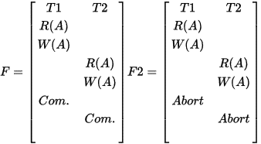
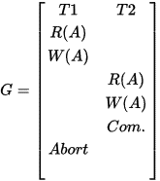
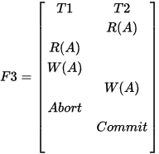
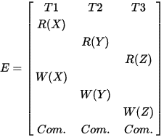
Schedule Examples
Recoverable
Unrecoverable
Cascadeless – lost update!
Serializable

Slide 30
Conflict serializability
T1 | T2
R(A)
W(A)
 | R(A)
R(B)
 | W(A)
W(B)
 | R(B)
 | W(B)
A schedule is conflict – serializable if by swapping
non conflicting operations
a serial schedule can be obtained

Slide 31
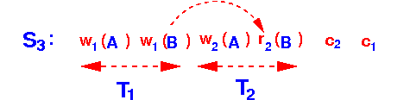
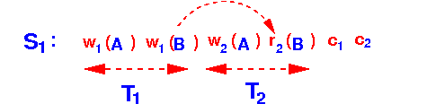

Serializability vs Recoverability
Two orthogonal concepts
Serializability = avoid problem of concurreancy
Recoverabilty = can restore the DB into a consistent state
One does not imply the other

Slide 32
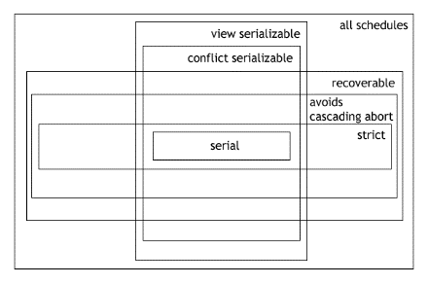

Slide 33
Concurrency Control

Slide 34
Database Concurrency Control
Why Concurrency Control is needed:
The Lost Update Problem.
The Temporary Update (or Dirty Read) Problem.
The Incorrect Summary Problem .

Slide 35
Database Concurrency Control
1 Purpose of Concurrency Control
To enforce Isolation (through mutual exclusion) among conflicting transactions.
To preserve database consistency through consistency preserving execution of transactions.
To resolve read-write and write-write conflicts.
Example: In concurrent execution environment if T1 conflicts with T2 over a data item A, then the existing concurrency control decides if T1 or T2 should get the A and if the other transaction should wait.

Slide 36
Database Concurrency Control
Locking Techniques: Binary Locking Scheme
A binary lock can have two states or values: locked (1) or unlocked (0)
If the value of the lock on item X is 1, item X cannot be accessed by a database operation that requests X.
If the value of the lock on item X is 0, item X can be accessed when requested.
The current value of the lock on item X is referred to as LOCK(X).
Binary locks are kept in a lock table which contains records where each record contains three fields:
<DB Item, LOCK, Locking Transaction>
Only items that are locked are kept in the table. Items that are not in the table are considered to be unlocked.

Slide 37
Database Concurrency Control
Locking Techniques: Binary Lock Operations
The following code performs the lock operation:
lock-item(X):
B: if LOCK (X) = 0 (*item is unlocked*)
then LOCK (X) ← 1 (*lock the item*)
else begin
wait (until lock (X) = 0 and
the lock manager wakes up the transaction);
goto B
end;
Critical sections…

Slide 38
Database Concurrency Control
Locking Techniques: Binary Lock Operations
The following code performs the unlock operation:
unlock-item(X):
LOCK (X) ← 0 (*unlock the item*)
if any transactions are waiting then
wake up one of the waiting the transactions;

Slide 39
Database Concurrency Control
Locking Techniques: Essential components
To use the binary locking scheme, every transaction must obey the following rules:
A transaction T must issue the operation lock_item(X) before any read_item(X) or write_item(X) operations are performed in T.
A transaction T must issue the operation unlock_item(X) after all read_item(X) or write_item(X) operations are completed in T.
A transaction T will not issue a lock_item(X) operation if it already holds the lock on item X.
A transaction T will not issue a unlock_item(X) unless it already holds the lock on item X.

Slide 40
Shared/Exclusive Locking Scheme
Two locks modes (a) shared (read) and (b) exclusive (write).
Shared mode: shared lock (X). More than one transaction can apply shared lock on X for reading its value but no write lock can be applied on X by any other transaction.
Exclusive mode: Write lock (X). Only one write lock on X can exist at any time and no shared lock can be applied by any other transaction on X.
LOCK(X) has now 3 states: “read_locked”, “write_locked” or “unlocked”.
Conflict matrix

Slide 41
Database Concurrency Control
Locking Techniques: Shared/Exclusive Lock Operations
The following code performs the read lock operation:
read_lock(X):
B: if LOCK (X) = “unlocked” then
begin LOCK (X) ← “read-locked”;
no_of_reads (X) ← 1;
end
else if LOCK (X) ← “read-locked” then
no_of_reads (X) ← no_of_reads (X) +1
else begin wait (until LOCK (X) = “unlocked” and
the lock manager wakes up the transaction);
go to B
end;

Slide 42
Database Concurrency Control
Locking Techniques: Shared/Exclusive Lock Operations
The following code performs the write lock operation:
write_lock(X):
B: if LOCK (X) = “unlocked” then
LOCK (X) ← “write-locked”;
else begin
wait (until LOCK (X) = “unlocked” and
the lock manager wakes up the transaction);
go to B
end;

Slide 43
Database Concurrency Control
Locking Techniques: Shared/Exclusive Lock Operations
The following code performs the unlock operation:
unlock(X):
if LOCK (X) = “write-locked” then
begin LOCK (X) ← “unlocked”;
wakeup one of the transactions, if any
end
else if LOCK (X) ← “read-locked” then
begin
no_of_reads (X) ← no_of_reads (X) -1
if no_of_reads (X) = 0 then
begin
LOCK (X) = “unlocked”;
wakeup one of the transactions, if any
end
end;

Slide 44
Database Concurrency Control
Locking Techniques: Essential components
Lock conversion
Lock upgrade: existing read lock to write lock
if Ti has a read-lock (X) and Tj has no read-lock (X) (i ≠ j) then
convert read-lock (X) to write-lock (X)
else
force Ti to wait until Tj unlocks X
Lock downgrade: existing write lock to read lock
Ti has a write-lock (X) (*no transaction can have any lock on X*)
convert write-lock (X) to read-lock (X)

Slide 45
Database Concurrency Control
Locking Techniques: Using Shared/Exclusive Locking
(Serial Transactions)
T1 T2 Result
read_lock (Y); read_lock (X); Initial values: X=20; Y=30
read_item (Y); read_item (X); Result of serial execution
unlock (Y); unlock (X); T1 followed by T2
write_lock (X); Write_lock (Y); X=50, Y=80.
read_item (X); read_item (Y); Result of serial execution
X:=X+Y; Y:=X+Y; T2 followed by T1
write_item (X); write_item (Y); X=70, Y=50
unlock (X); unlock (Y);

Slide 46
Database Concurrency Control
Locking Techniques: Using Shared/Exclusive Locking (Interleaved Transactions)
T1 T2 Result
read_lock (Y); X=50; Y=50
read_item (Y); Nonserializable.
unlock (Y);
read_lock (X);
read_item (X);
unlock (X);
write_lock (Y);
read_item (Y);
Y:=X+Y;
write_item (Y);
unlock (Y);
write_lock (X);
read_item (X);
X:=X+Y;
write_item (X);
unlock (X);
Time

Slide 47
Database Concurrency Control
Two-Phase Locking Techniques: The algorithm
Two Phases: (a) Locking (Growing) (b) Unlocking (Shrinking).
Locking (Growing) Phase: A transaction applies locks (read or write) on desired data items one at a time.
Unlocking (Shrinking) Phase: A transaction unlocks its locked data items one at a time.
Requirement: For a transaction these two phases must be mutually exclusively, that is, during locking phase unlocking phase must not start and during unlocking phase locking phase must not begin.

Slide 48
Database Concurrency Control
Two-Phase Locking Techniques: The algorithm
T1’ T2’
read_lock (Y); read_lock (X); T1’ and T2’ follow two-phase
read_item (Y); read_item (X); policy but they are subject to
write_lock (X); write_lock (Y); deadlock, which must be
unlock (Y); unlock (X); dealt with.
read_item (X); read_item (Y);
X:=X+Y; Y:=X+Y;
write_item (X); write_item (Y);
unlock (X); unlock (Y);

Slide 49
Dealing with Deadlock and Starvation
Dealing with Deadlock and Starvation
Deadlock
T1’ T2’
read_lock (Y); T1’ and T2’ did follow two-phase
read_item (Y); policy but they are deadlock
read_lock (X);
read_item (X);
write_lock (X);
(waits for X) write_lock (Y);
(waits for Y)
Deadlock (T’1 and T’2)

Slide 50
Database Concurrency Control
Dealing with Deadlock and Starvation
Deadlock Prevention
A transaction locks all data items it refers to before it begins execution. This way of locking prevents deadlock since a transaction never waits for a data item. The conservative two-phase locking uses this approach.

Slide 51
Database Concurrency Control
Dealing with Deadlock and Starvation
Deadlock Prevention
Other deadlock prevention algorithms use the concept of a timsestamp TS(T) which is a unique identifier assigned to transactions based on the order in which they start. If T1 starts before T2, then
TS(T1) < TS(T2) (older transaction has the smaller timestamp value)
Examples of such algorithms are:
Wait-die: If TS(Ti) < TS(Tj), then (Ti is older than Tj) Ti is allowed to wait; otherwise (Ti younger than Tj) abort Ti (Ti dies) and restart it later with the same timestamp.
Wound-wait: If TS(Ti) < TS(Tj), then (Ti is older than Tj) abort Tj (Ti wounds Tj) and restart it later with the same timestamp; otherwise (Ti younger than Tj) Ti is allowed to wait.

Slide 52
Database Concurrency Control
Dealing with Deadlock and Starvation
Deadlock Detection and Resolution
In this approach, deadlocks are allowed to happen. The scheduler maintains a wait-for-graph for detecting cycle. If a cycle exists, then one transaction involved in the cycle is selected (victim) and rolled-back.
Another approach to deal with deadlock is the use of timeouts. In this method, if a transaction waits for a period of time longer than a system-defined timeout period, the system assumes that a transaction maybe in s state of deadlock and aborts it regardless of whether a deadlock actually exists or not.

Slide 53
Database Concurrency Control
Dealing with Deadlock and Starvation
Starvation
Starvation occurs when a particular transaction consistently waits or restarted and never gets a chance to proceed further. In a deadlock resolution it is possible that the same transaction may consistently be selected as victim and aborted. This limitation is inherent in all priority based scheduling mechanisms. In Wound-Wait scheme a younger transaction may always be wounded (aborted) by a long running older transaction which may create starvation.

